Slide 1
SEMurai Data Driven Integration Tests
Prepared By: Elazar Neeman
Event name and date

Slide 2
Project Goal
Shorten release regression time
Detect issues near to the time as they happen
Increase software quality
Easy test creation

Slide 3



The Framework
A DevOps framework that allows any developer or tester (or PL) to create a test scenario that includes:
An input (recipe / waveform)
A set of expected results
A context environment (CCI configurations and licenses setup)
The scenario is recorded by a GUI tool available at the development \ test environment
The creator of the test scenario does not need any special knowledge or skills
Just to be able to create a recipe in the system

Slide 4

Background - solution concept
Test Report
V | TP1
X | TP2
V | TP3
GIT SEMurai
Repo
Test CI Job
References
Test Packages

Slide 5
Test Package (TP)
Test Package (TP)
Arrange Data
Recipe
CCI
Assert Data
Metadata
Meas. Results
…
Software Versions
Scenario Description
Test Type

Slide 6

Background - solution concept
SEMurai
Run regression
scenarios
Events & Query
Test Suite Package
Start & Configure Recorder
Test Package (TP)
QA
Recorder
Test Suite
Package

Slide 7
The Tests
Recipe test
Loads part of the SEMurai processes
Imports recipe
Execute recipe
Compare important CD results with saved results
Optimizer test
Loads part of the SEMurai processes
Imports waveform
Execute optimizer
Compare important CD results with saved results

Slide 8
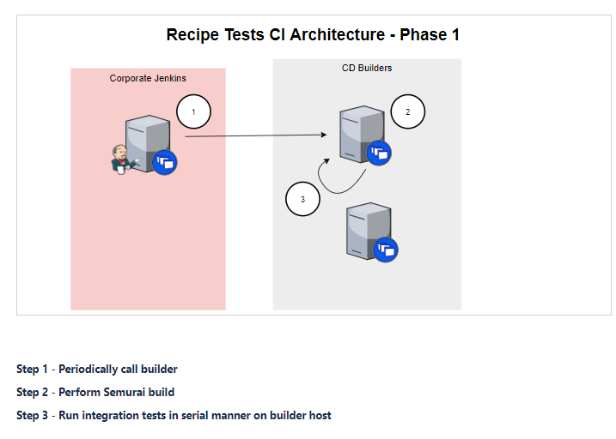
The CI Job

Slide 9
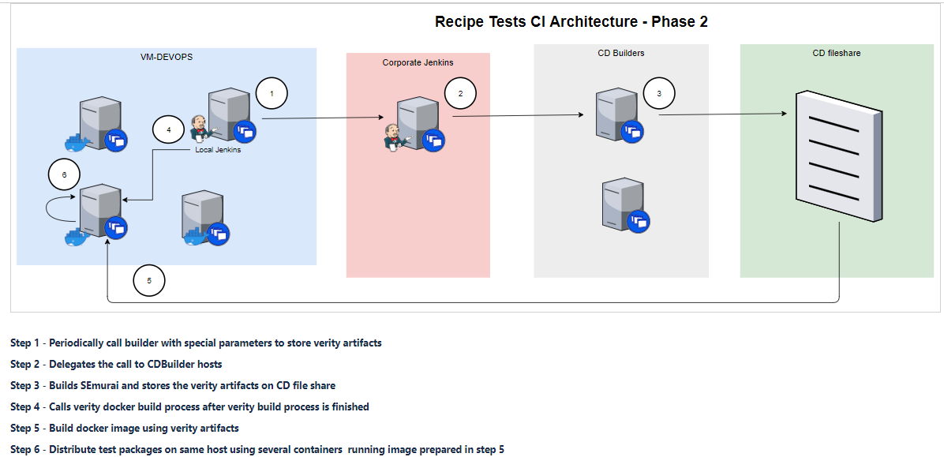
The CI job (in progress)

Slide 10
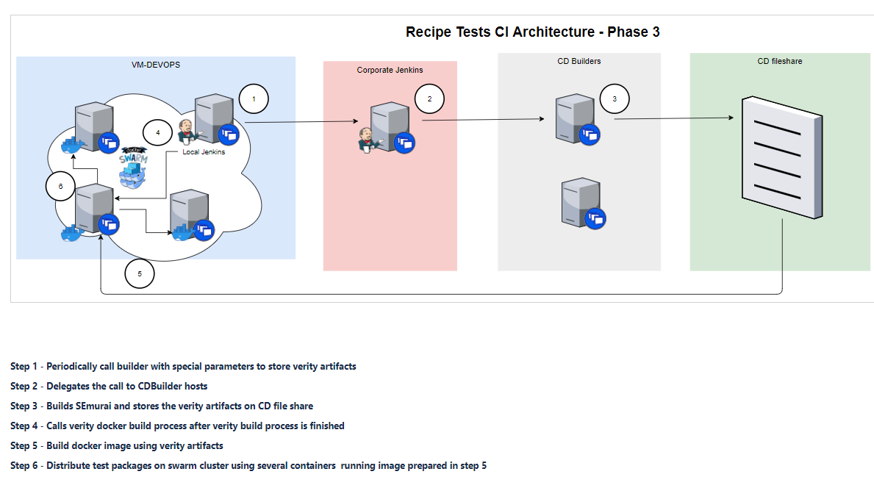
The CI job - next steps

Slide 11
Project Next Steps
Run the tests in Docker
Change the CI flow to work with dockers
Better assertions / assertion infra
Prepare recorder for QA to record more test packages
Run cluster of dockers to allow run many tests in parallel
Make more test harness for regression scenarios
Support multiple environments
Results analytics

Slide 12
Challenges
Computing resources - docker hosts
Internet access for docker host
Applicative user
Custom host setup like ESX
Docker clustering service like Kubernetes for Windows
Nexus service for CD / Docker repository
Test results analytics service like ELK
Host management – backup restore self service

